Slide 1
SAT grammar learning
By Theos Huang
2015.4.7

Slide 2

Curriculum Introduction
Overview of SAT
Improving Sentence （改进句子）
Identifying Sentence Error （改错）
Improving Paragraph（改进文章）
Practice of OG & the exam questions

Slide 3
Catalog for the Fourth Class
Ⅰ.Overview of the Sentence Grammar
Point 7 – 不间断句子
Point 8 – 不完整句子
Ⅱ. Review
Ⅲ. Homework

Slide 4
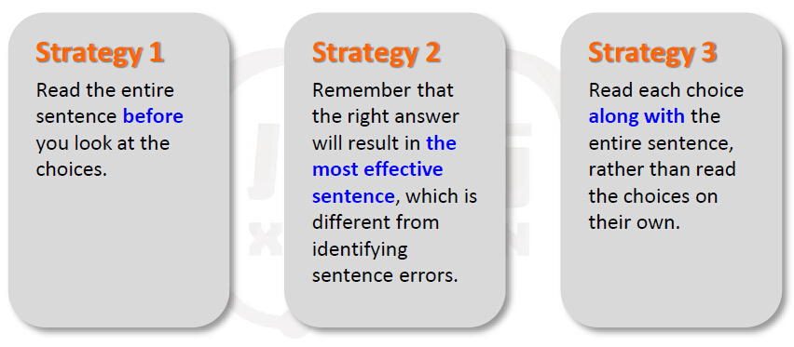
1.1 How to deal with the SAT Grammar

Slide 5
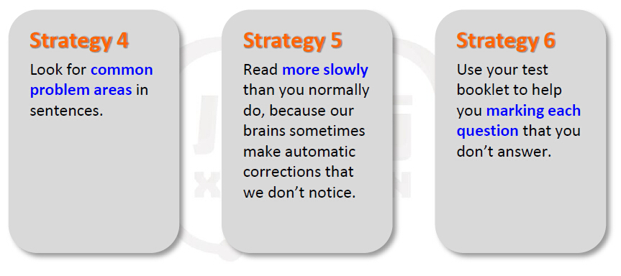
1.2 How to deal with the SAT Grammar

Slide 6
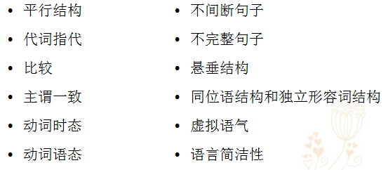
1.3 How to deal with Improving Sentence
Points

Slide 7
2. 1 Pre-test
In 1984, the United States defeated rival countries to win its first Olympic all-around gold medal in gymnastics, even so, they did not win again until 2004.
A gymnastics, even so, they
B gymnastics, so they
C gymnastics, they
D gymnastics; as a result, it
E gymnastics, but it

Slide 8
2. 2 Improving Sentences: Point 7 ---不间断句子
不间断句子
不间断句，没有任何连接词或冒号、分号来对两个句子进行连接,在英文中称为run-on sentence，是指两个完整的独立句之间。如：
I love English, Mary loves French.
这个句子包含了两个独立的完整句，但中间没有连接词，也没有冒号或分号，所以是不间断句子。正确的表达应该是：
I love English while Mary loves French.
I love English; Mary loves French. (分号的功能相当于一个连词)
上述两个句子分别用while和分号作为连接成分，而且用while或分号也可以表达出两个句子的对比关系。

Slide 9
在SAT的improving sentence中，五个选项里往往有多个选项含有不间断句子这样的错误，所以正确认识run-on sentence可以帮助我们迅速排除无关选项，从而更容易找出正确答案。
Many players became truculent in the playing field, although calm in their daily life, they do the contrary when in a match.
完整化：
Many players became truculent in the playing field, although (they are) calm in their daily life, they do the contrary when (they are) in a match.

Slide 10
在状语从句中，当从句的主语和主句的主语一致并且从句的动词为be动词时，从句的主语和be动词均可省略，上述例句即为一例，再如：
Although (he is) old, Tom is in good health.

Slide 11
在improving sentence题型中，许多考生的注意力往往集中在划线部分，而忽视了未划线部分与划线部分的有效连接，这也是考生不能正确挑出run-on句子的一个重要原因。
考生应通读整个句子、了解句子的大意、找出句子可分为几个子句、每个子句的主语和谓语部分在哪里、子句之间的联系词是否存在。以此步骤，即可迅速找出句子是否为run-on形式。
★ SAT常把一个子句的主语和谓语分离，使其相隔很远，借以迷惑考生

Slide 12
一般来讲，在一个大句子中，你找出两个子句，就必须有一个连词；找出三个子句，就必须有两个连词。凡是连词不够的，该大句子即为run-on。
值得注意的是，在非正式文体中，两个完整句子中间常常没有连词，这主要是因为在一些复合句中，习惯用逗号来代替本应存在的连词（主要是and和but）。这种无连词的句子在普通英文中可以接受，但对SAT不适用。
例：She is pretty, she is smart.

Slide 13
Hot tip!
要特别注意下面六个词，它们常被错认为是连词，但事实上并不是，也不能作为连词来连接两个完整句子。
这六个词是：
thus, therefore, consequently, however, nonetheless, nevertheless
这六个词前面必须有句号或分号，否则全句为run-on。
例：The policy is intended to encourage the employees, however, it has frustrated those employees with initiatives.

Slide 14
Hot tip!
英文中有几个似乎不是连词的单词却可以作为连词使用：
the moment, immediately, everywhere(anywhere)
The woman cried the moment she heard the news.
(此处the moment相当于连词短语as soon as)
We came out immediately the rain had stopped.
(此处immediately相当于as soon as或once)
Everywhere she appeared, she was admired.
(此处everywhere相当于no matter where)
◆在SAT的Improving Sentence和Identifying Sentence Error题型中，看到类似上述句子时，不要简单地认为是run-on。

Slide 15
2.3 Sample
In 1984, the United States defeated rival countries to win its first Olympic all-around gold medal in gymnastics, even so, they did not win again until 2004.
A gymnastics, even so, they
B gymnastics, so they
C gymnastics, they
D gymnastics; as a result, it
E gymnastics, but it

Slide 16
2.4 Exercise 1
According to Greek myth, Zeus’s inability to control his lust, this made his wife, Hara, extremely angry.
A Zeus’s inability to control his lust, this made his wife
B When out of control, his lust made his wife
C Zeus’s inability at controlling his lust was making his wife
D Zeus’s inability to control his lust made his wife
E the lack of control over his lust that Zeus exhibited made his wife

Slide 17
2.5 Exercise 2
The others in my horseback riding class are very accomplished; they win ribbons in every competition they enter.
A accomplished; they win
B accomplished; which allows them to win
C accomplished, they have been winners
D accomplished, and so they would win
E accomplished, by winning

Slide 18
2.6 Exercise 3
Although a few studies have shown that a disproportionate number of artistic people are left-handed, the connection between left-handedness and creativity remains highly debated.
A Although a few studies have shown that
B A few studies have shown that
C Therefore, a few studies have shown
D Where a few studies have shown that
E Conversely, a few studies have shown

Slide 19
2.7 Exercise 4
The marathon runner’s early burst of speed had been exciting to some, she was slower after several miles.
A had been exciting to some, she was
B had been exciting to some; however, she was
C had been exciting to some; and she had been
D excited some, while she was
E excited some, but she is

Slide 20
2.8 Exercise 5
The nondisclosure agreement protects the company’s trade secrets, but signing it is required of all new employees.
A but signing it is required of all new employees
B therefore the singing of it is required of all new employees
C signing it is required of all new employees
D and they required all new employees to sign it
E so all new employees are required to sign it

Slide 21
2.9 Exercise 6
In the sixteenth century a group of Scottish nobles ended their traditional French alliance, they joined forces with the King of England in hopes of combining the two kingdoms.
A alliance, they joined forces
B alliance; they had joined forces
C alliance; they joined forces
D alliance, and so they would join forces
E alliance; in this way joining forces

Slide 22
2.10 Exercise 7
The quarterback's lack of aim had been exasperating to his team and he was more accurate after several games.
A had been exasperating to his team and he was
B had been exasperating to his team; but he had been
C had been exasperating to his team, but he became
D exasperated his team, however he became
E exasperated his team, while he was

Slide 23
2.11 Exercise 8
Saxophone playing must be enjoying a surge in popularity, nearly 25 members of our marching band play the sax.
A a surge in popularity, nearly 25 members
B a surge in popularity, although 25 members
C a surge in popularity, and nearly 25 members
D a surge in popularity; nearly 25 members
E a surge in popularity, while nearly 25 members

Slide 24
2.12 Exercise 9
Out-of-state students usually do not end up receiving as much financial aid as local students do, this being why so many students choose to attend college in their home state.
A do, this being why so many students
B do, this is why so many students
C do; this fact explains why so many students
D do; this fact explaining the reason for why so many students
E do; explaining why so many students

Slide 25
2.13 Further questions （后测）
The Lions, a strong offensive team, complete against the Cowboys, they play tough defense.
A Cowboys, they play
B Cowboys, who plays
C Cowboys, having played
D Cowboys; playing
E Cowboys; for playing

Slide 26
3.1 Pre-test
Word had it that employees using the latest version of word processing software to produce documents streamlining the week’s work schedule.
A using the latest version of word processing software to produce documents streamlining
B using the latest version of word processing software to produce documents and streamline
C using the latest version of word processing software and producing documents, they streamlined
D were using the latest version of word processing software to produce documents, thus streamlining
E used the latest version of word processing software, so streamlining methods of

Slide 27
3. 2 Improving Sentences: Point 8 ---不完整句子
不完整句子
英语中的不完整句子，是指整个句子中，因为缺少某个成分，使得句子语法结构不完整，并且造成理解上的困难。
虽然因为修辞的需要，普通英文中的不完整句子并不少见，但SAT绝对不接受不完整句子。在Improving Sentence题型中，不完整句子的选项一定是错误选项。
SAT语法考试中，不完整句子现象大致可分为以下几类：

Slide 28
1. 从 句 单 独 使 用
SAT往往在一个独立的从句前，有一个语法句意很完整的句子，以此来麻痹考生。在该完整句后有一个句号，句号后紧跟一个独立存在的从句。
例：He sat there reading newspaper every night. As he had been for the past seven nights.
在上句中，as所引导的时间从句本应和前面的句子构成一个完整的大句子，中间的句号使该句独立存在，形成了英文中的fragment sentence。

Slide 29
2. 一个句子中谓语部分不完整或仅有谓语而无主语
英文中的谓语，很多时候由两个甚至两个以上的部分组成。
例：Mary is reading a novel.
在上句中，is reading作为句子的谓语表示动作正在进行。但是若把is去掉，则全句为fragment sentence，即Mary reading a novel。
一般考生会觉得上述句子有问题，所以SAT不会这样考。它往往会把一个句子的主语和谓语分隔很远，中间插入一些迷惑成分，如上句可以写成：

Slide 30
Mary, who is a pretty girl from China, reading a novel with her friends.
这个句子依然是fragment sentence，因为主语Mary在句子中找不到谓语成分与其匹配，应该把reading a novel改为is reading a novel。
但大家应该注意，SAT真题会比这个例子在句意和用词上更复杂。

Slide 31
还有一种情况就是句子的谓语部分是完整的，但句子缺少一个合适的主语。
例：After dinner, Mary left her dirty dishes on the table. And let cat which was hungry eat the leftovers.
上句中，let是完整的谓语，但是没有主语，所以应该改为：
After dinner, Mary left her dirty dishes on the table, and let cat which was hungry eat the leftovers.

Slide 32
3. 现在分词(-ing)或动词不定式(to do)单独成句
现在分词和动词不定式只能放在完整句子中作句子的一个补充成分，不能独立成句。
例：Mary always wears a helmet when riding a bicycle. Worrying that she may be hit on the road by a flying stone.
例中划线部分虽然有一个从句，但worrying后的从句没有可依附的主句，故全句依然是fragment sentence。

Slide 33
例: To explain why she has been so late for class. Mary fabricated a lot of excuses.
划线部分也是动词不定式fragment，应该把class后的句号改为逗号，使动词不定式结构依附于主句存在。

Slide 34
4. 双主语 Fragment
SAT的习惯做法是先说一个主语，在这个主语后面加入一些修饰成分，然后在修饰成分后再接上一个完整的句子，而该句的主语和修饰成分前的主语指同一人或物。
例：Mary, a pretty gril from China, she is now studying in Canada.
上句中，Mary用于句首必为句子主语，所以应当有相应的谓语成分，但是应接的谓语is studying前本身带有主语she，导致作为句子的Mary没有谓语动词。
这种题型是SAT常见的一中fragment形式。

Slide 35
5. 其他fragment形式
A. 作为举例的such as单独使用
例：Mary has done several things to imitate her parents. Such as coming home late, reading novels in class and never flushing toilet after use.
在SAT中，列举的例子如果是一句话，要用“For example + 句子”的形式，这才不算fragment。如果列举的例子不是个完整的句子，则一律用such as，而不用like。

Slide 36
B. especially (或including) + 句子或词组单独使用
例1：I hate to study English at night. Especially when I was sleepy.
例2：The company manufactures a wide range of products. Including TV set, computers and iPod.

Slide 37
C. 因介词问题造成的fragment
这是SAT语法考试中非常不易发现的一中fragment，在Identifying Sentence Error中很常见。
例1：We appreciate you for your interest and support for our products.
此句中，support for和products连接没有问题，但interest和our products就不能有效连接了，所以应该在interest后加上介词in。
例2：The fire caused damage and destroyed the forest.
应该在damage后加上to以和the forest连接。

Slide 38
例3：She is good and successful in Math.
应该在good后加上at以和Math连接。
例4：The policy was reasoned and adopted by the government.
应在adopted前加上was，被动语态前的助动词was不可省。

Slide 39
在表示时间、条件或让步的状语从句中，当从句的主语和主句的主语一致，并且从句的谓语里有be动词的时候，可以把从句的主语和be动词一并省略，这种情况不算是fragment.
例：When (I was) in Thailand, I was impressed by its exotic culture.
While (she was) young, Mary began to learn English.
Although (she is) old, she is energetic.

Slide 40
当从句的主语和主句的主语一致，而从句的谓语没有be动词的时候，可以把从句的主语省略，而谓语采用doing的形式。
例：When I traveled in Beijing, I met a lot of friends.
= When travelling in Beijing, I met a lot of friends.

Slide 41
3.3 Sample
Word had it that employees using the latest version of word processing software to produce documents streamlining the week’s work schedule.
A using the latest version of word processing software to produce documents streamlining
B using the latest version of word processing software to produce documents and streamline
C using the latest version of word processing software and producing documents, they streamlined
D were using the latest version of word processing software to produce documents, thus streamlining
E used the latest version of word processing software, so streamlining methods of

Slide 42
3.4 Exercise 1
The solution to global warming, not completely agreed upon around the world because of various political and corporate interests.
A warming, not completely agreed upon around the world because
B warming, not completely agreed upon around the world and
C warming, not completely agreed upon around the world when
D warming is not completely agreed upon around the world because
E warming is not completely agreed upon around the world and

Slide 43
3.5 Exercise 2
Both Cinderella and Snow White being dependent on a prince to rescue them from unfortunate circumstances.
A Both Cinderella and Snow White being dependent on a prince to rescue them from unfortunate circumstances
B Both Cinderella and Snow White were dependent on a prince to rescue them from unfortunate circumstances
C Dependent on a prince to rescue them from unfortunate circumstances being both Cinderella and Snow White
D Unfortunate circumstances were what both Cinderella and Snow White were dependent on a prince to rescue them from
E Dependent on a prince to rescue them from unfortunate circumstances was both Cinderella and Snow White

Slide 44
3.6 Exercise 3
The mule refused to eat the oats, he kicked over the bucket to show his displeasure.
A The mule refused to eat the oats, he
B The mule, having refused to eat the oats, he
C In addition to refusing to eat the oats, the mule
D The oats, which the mule refused to eat, were
E The oats were initially refused by the mule, then

Slide 45
3.7 Exercise 4
D.H. Lawrence, one of the most prolific novelists of his time, writing more than 40 volumes of fiction, poetry, and drama from 1911 to 1930.
A time, writing more than 40 volumes of fiction, poetry, and drama from 1911 to 1930
B time, writing more than 40 volumes, which he wrote from 1911 to 1930 in the areas of fiction poetry, and drama
C time, and he wrote more than 40 volumes of fiction, poetry, and drama from 1911 to 1930
D time, wrote more than 40 volumes of fiction, poetry, and drama from 1911 to 1930
E time, his fiction, poetry, and drama amounting to more than 40 volumes from 1911 to 1930

Slide 46
3.8 Exercise 5
Scientists once believed that the universe was decelerating, the reason was that they believed gravity would slow acceleration by pulling the planets towards each other.
A decelerating, the reason was that they believed gravity would slow acceleration
B decelerating, it is believed gravity would slow acceleration
C decelerating; because they believed gravity would slow acceleration
D decelerating because they believed gravity would slow acceleration
E decelerating because their belief had been that gravity would slow acceleration

Slide 47
3.9 Exercise 6
Although most people think of Egyptian papyrus as the earliest paper, during the Han Dynasty, the Chinese developing a process to create paper from individual plant fibers that was much closer to techniques used in modern papermaking.
A the Chinese developing a process to create paper from individual plant fibers that
B the Chinese developing a process and creating paper from individual plant fibers that
C the Chinese developing a process to create paper from individual plant fibers, it
D the Chinese developed a process to create paper from individual plant fibers, it
E the Chinese developed a process to create paper from individual plant fibers that

Slide 48
3.10 Exercise 7
As weather conditions improve, the Department of Public Works promising that it will be able to improve road conditions by working overtime.
A promising that it will be able to improve road conditions by
B promising that it, able by improving road conditions and
C promises that it will improve road conditions and
D promises that it will be able to improve road conditions by
E promises that improving road conditions by

Slide 49
3.11 Exercise 8
The young pianist's beautiful melodic line and tone is remarkably like her mother’s violin playing, in which warmth, imagination, and speedy fingering are elegantly combined.
A tone is remarkably like
B tone, remarkably like
C tone, remarkable and like
D tone are remarkably like
E tone remarkable similar to

Slide 50
3.12 Exercise 9
Although the dancers were nervous at the beginning of their performance, having shown remarkable ease as the performance progressed.
A having shown remarkable ease as the performance
B once they have showed remarkable ease when the performance had been
C but showing remarkable ease as the performance
D they showed remarkable ease as the performance
E but they showed remarkable ease when the performance

Slide 51
3.13 Exercise 10
Although the college has begun to decrease the size of its classes, it is still receiving hundreds of protest letters.
A Although the college has begun to decrease the size of its classes,
B Although beginning to decrease, as the college, the size of its classes,
C The college, beginning to decrease the size of its classes,
D The college has begun to decrease the size of its classes, and
E The college, beginning to decrease the size of its classes, however

Slide 52
3.14 Exercise 11
As their work load gets heavier, first year law students trying to keep up with their assignments by drinking a lot of coffee.
A trying to keep up with their assignments by
B trying to keep up with their assignments and
C tried to keep up with their assignments by
D try to keep up with their assignments by
E trying keeping up with their assignments by

Slide 53
3.15 Further questions （后测）
The problem of bias in journalism, often exacerbated in some countries because the government controls the media.
A journalism, often exacerbated in some countries because
B journalism, often exacerbated in some countries and
C journalism, often exacerbated in some countries when
D journalism is often exacerbated in some countries where
E journalism is often exacerbated in some countries so

Slide 54
Ⅱ. Review
两个语法点：
不间断句子
不完整句子

Slide 55
Ⅲ. Homework
做OG Practice Test 中有不间断句子、
不完整句子的语法题。

